Slide 1
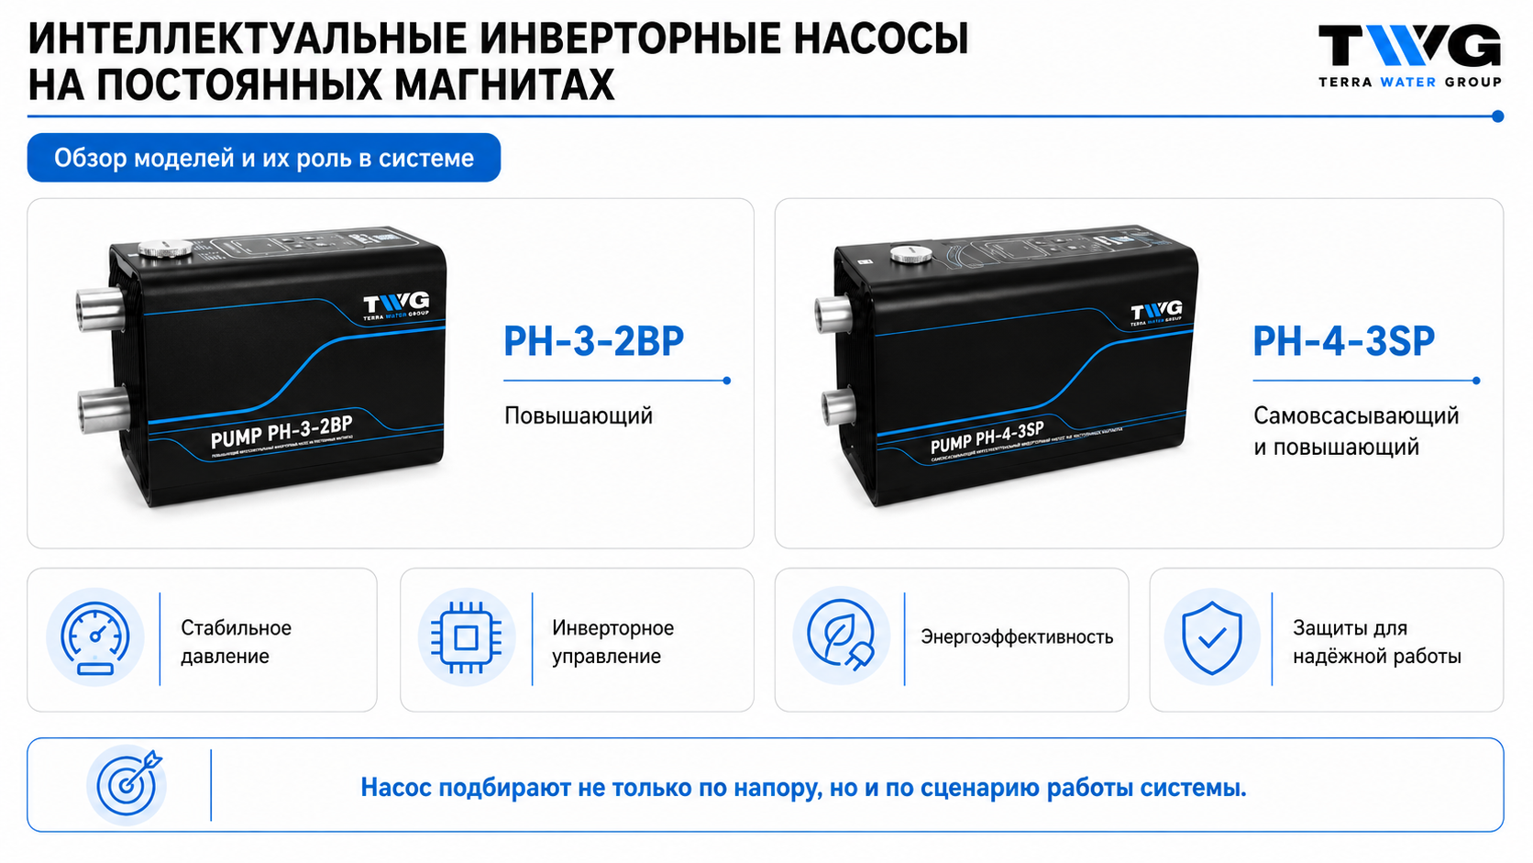
Notes:
Sources: user-provided TWG product images; Каталог ТВГ 2025_А5.pdf; slide image generated for TWG training. Slide: Обзор моделей насосов TWG.

Slide 2
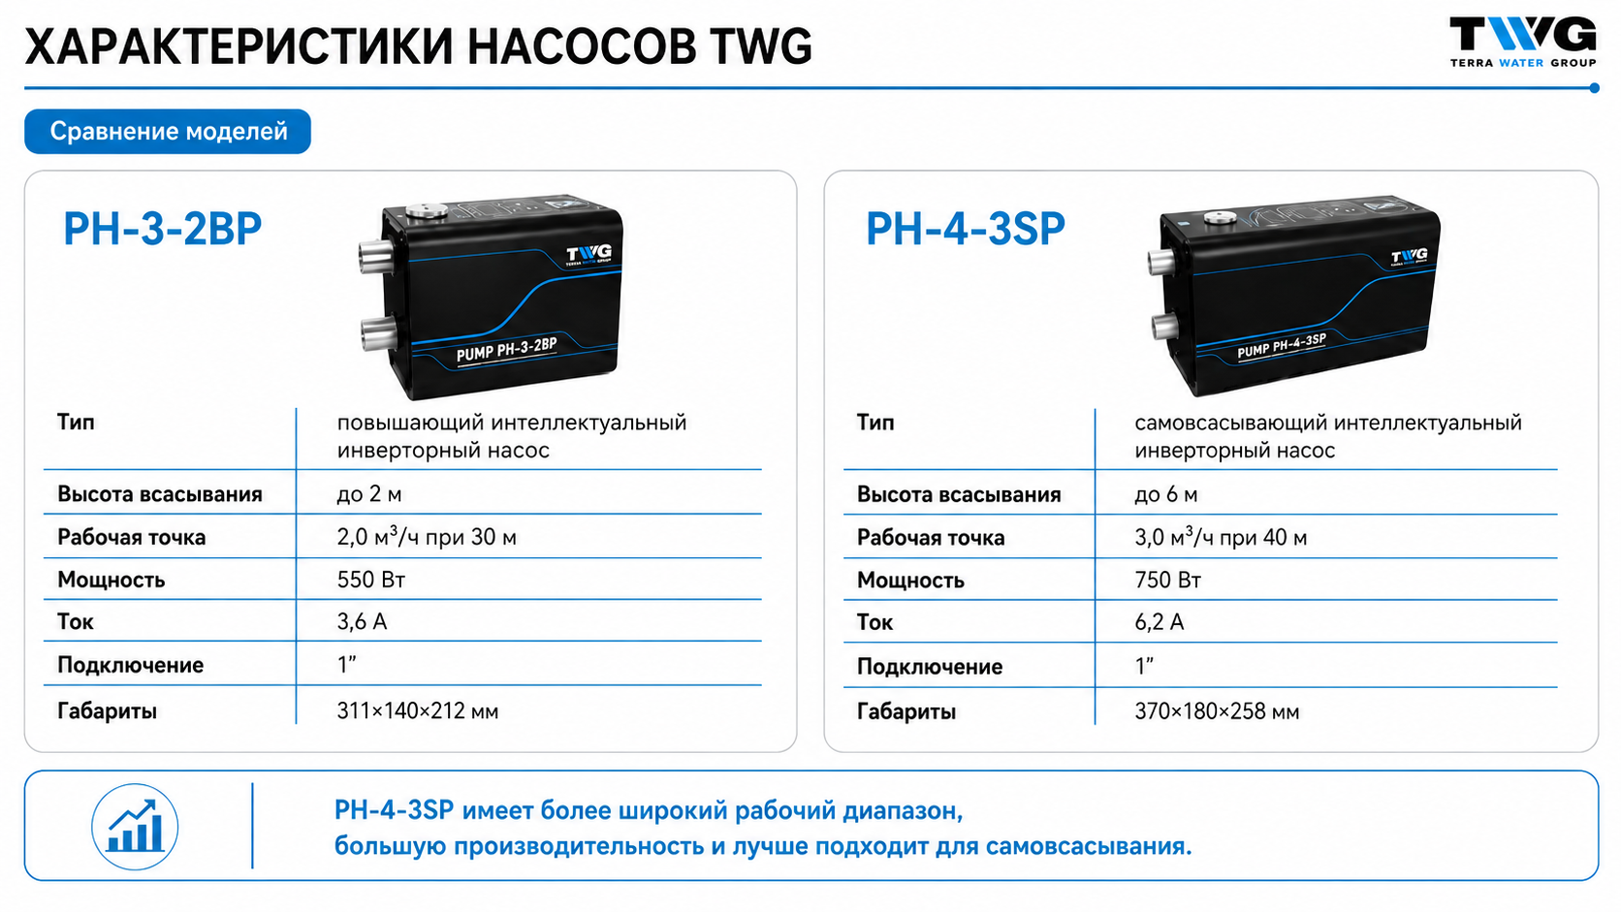
Notes:
Sources: user-provided TWG product images; Каталог ТВГ 2025_А5.pdf; slide image generated for TWG training. Slide: Характеристики насосов TWG.

Slide 3
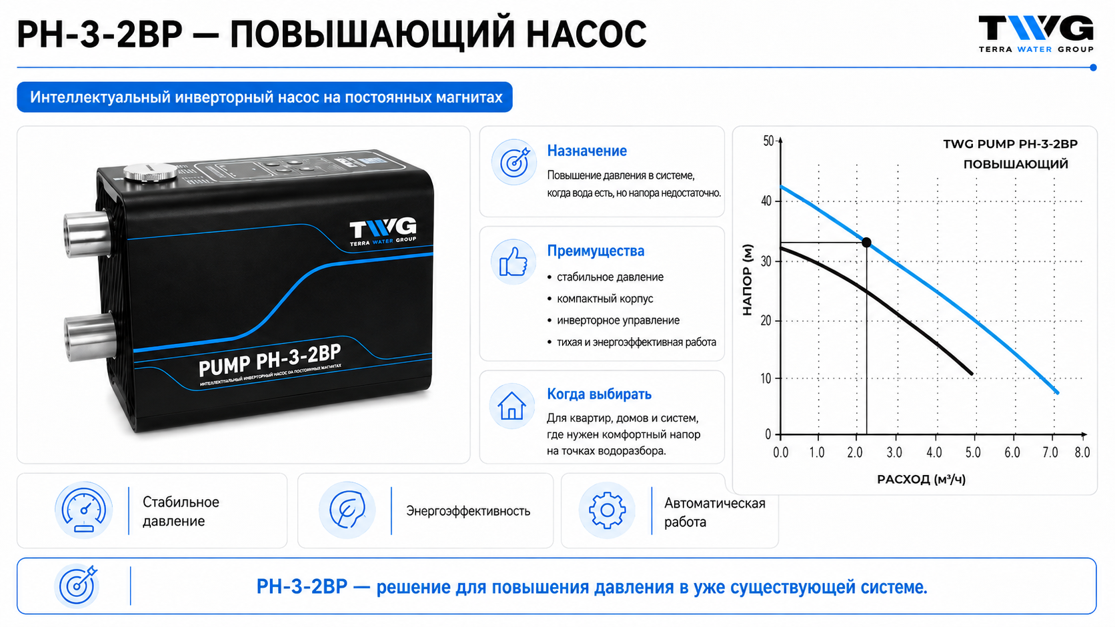
Notes:
Sources: user-provided TWG product images; Каталог ТВГ 2025_А5.pdf; slide image generated for TWG training. Slide: PH-3-2BP: расход-напор.

Slide 4
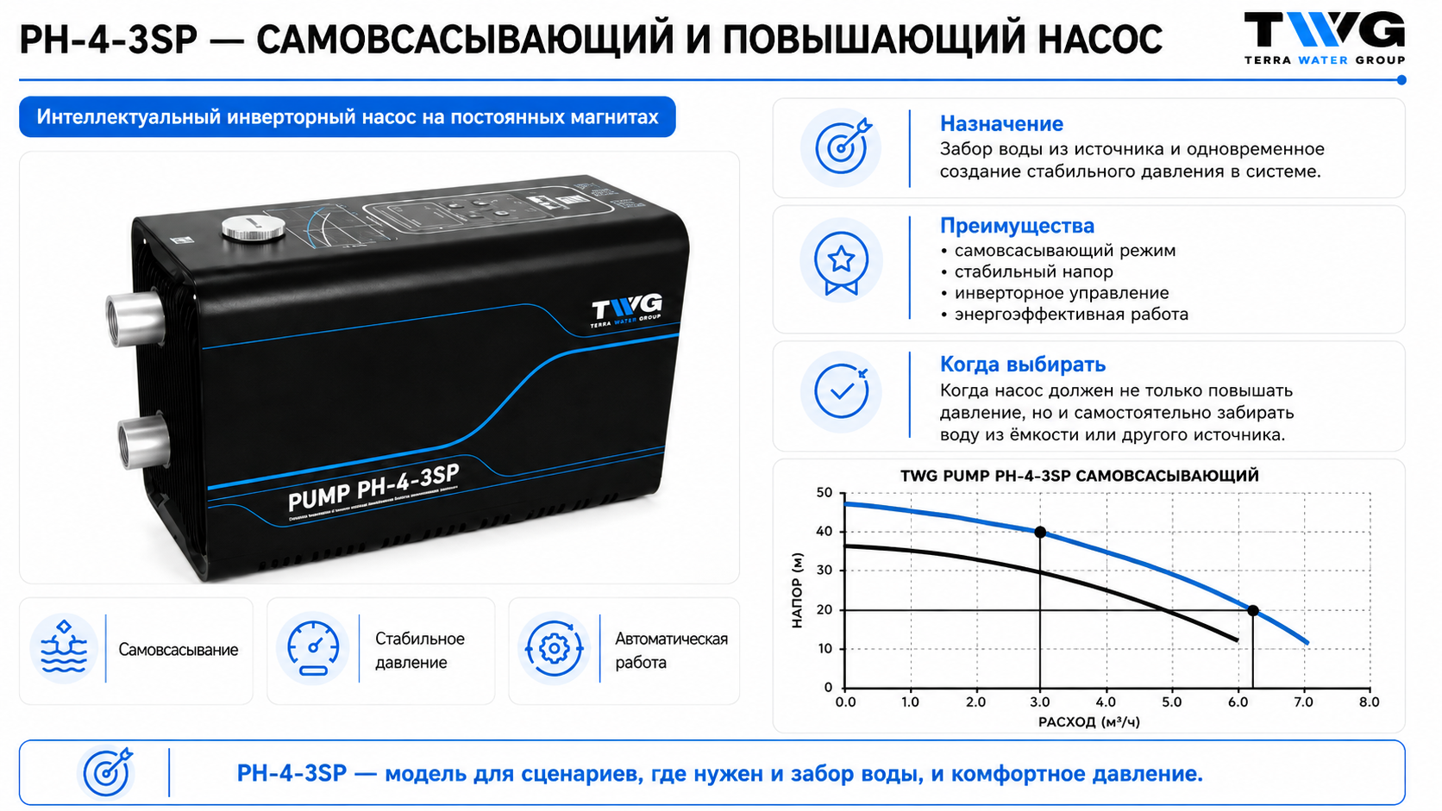
Notes:
Sources: user-provided TWG product images; Каталог ТВГ 2025_А5.pdf; slide image generated for TWG training. Slide: PH-4-3SP: расход-напор.

Slide 5
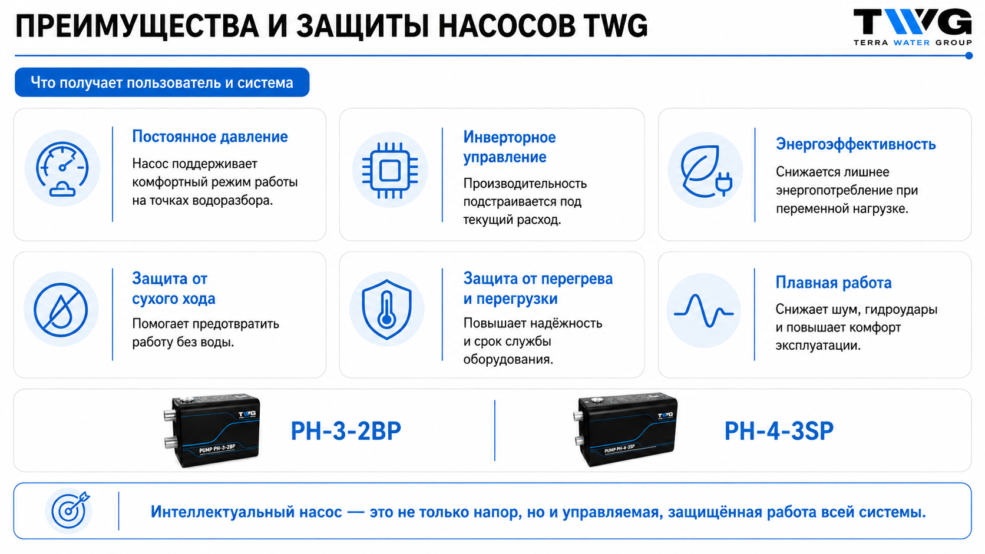
Notes:
Sources: user-provided TWG product images; Каталог ТВГ 2025_А5.pdf; slide image generated for TWG training. Slide: Преимущества и защиты насосов TWG.

Slide 6
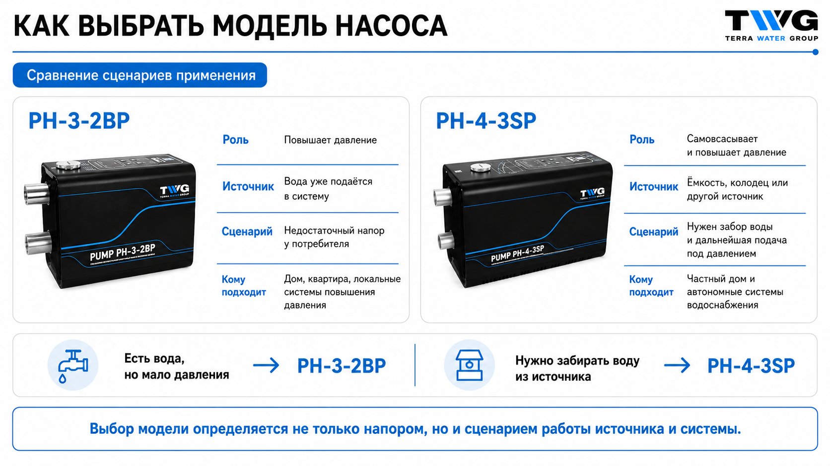
Notes:
Sources: user-provided TWG product images; Каталог ТВГ 2025_А5.pdf; slide image generated for TWG training. Slide: Алгоритм выбора насоса TWG.

